Slide 1
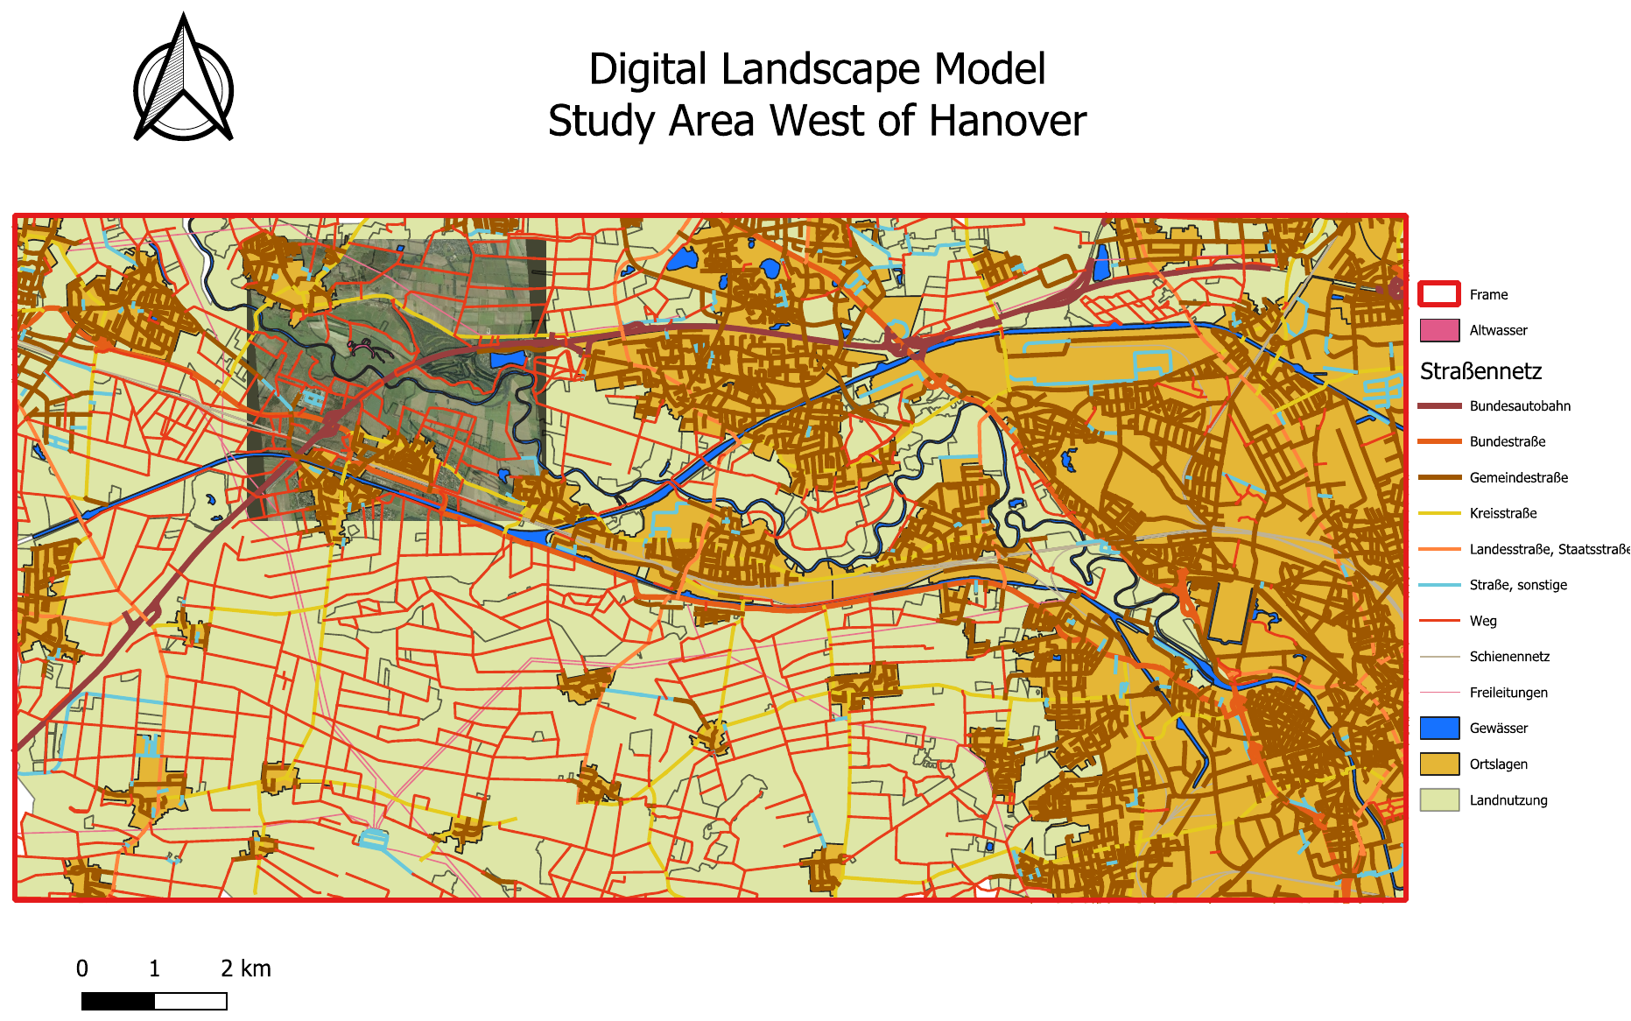
Methods for the Analysis and Modelling of Spatial Environmental Data
Wind Farm Suitability
Analysis
West of Hanover
Data Preparation · Georeferencing · Digitization
Nadia Farsiani
The Digital Landscape Model (Map 1) — the final deliverable
Notes:
Our project was to find suitable areas for wind turbines west of Hanover. We split it into three stages, and mine was the first — preparing all the data the analysis runs on. So I'll cover the setup, the georeferencing, digitizing the river oxbows, and the first map, and then hand over to Khalid and Tai le for the buffers and the final result.

Slide 2
The task, and my part in it
In an area of about 200 km² west of Hanover, suitable areas for wind turbines are to be identified from a Digital Landscape Model (DLM). My stage prepares the data the rest of the analysis is built on.
1
2
3
4
Setup & CRS
Georeference
Digitize
DLM map
New project; 7 layers; EPSG:31467
Aerial photo → map coordinates
Trace the Leine oxbow arms
Assemble & export Map 1
Notes:
The Task was, in an area of about 200 square kilometres west of Hanover, we needed to find land suitable for wind turbines.
To do that we work from a Digital Landscape Model, so basically all the geographic layers of the area: roads, railways, water, settlements, land use.
My stage was these four steps: I set up the project and coordinate system, georeference the aerial photo, digitize the old arms of the Leine river, and produce the first map.

Slide 3
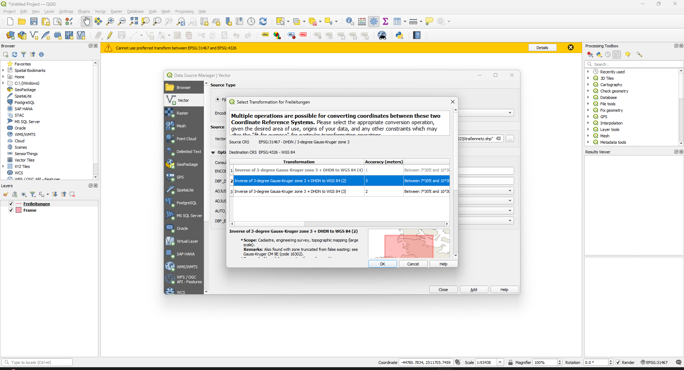
1
STEP 1 OF 5
Project setup and coordinate system
Created a new QGIS project and loaded all seven shapefiles
Checked the coordinate system: every layer is in EPSG:31467 (Gauss-Krüger zone 3)
The project adopted this CRS from the data, so no reprojection was needed.
All distances and areas are therefore measured in true meters directly.
EPSG:31467
projected coordinate system · unit = metre
Notes:
I started by creating a new QGIS project and loading the seven supplied layers. The key thing at this stage was the coordinate system. All the data's already in EPSG three-one-four-six-seven, a projected system in metres. That's what we need, because our rules are all distances and areas. So here I just confirmed the coordinate system was right.

Slide 4
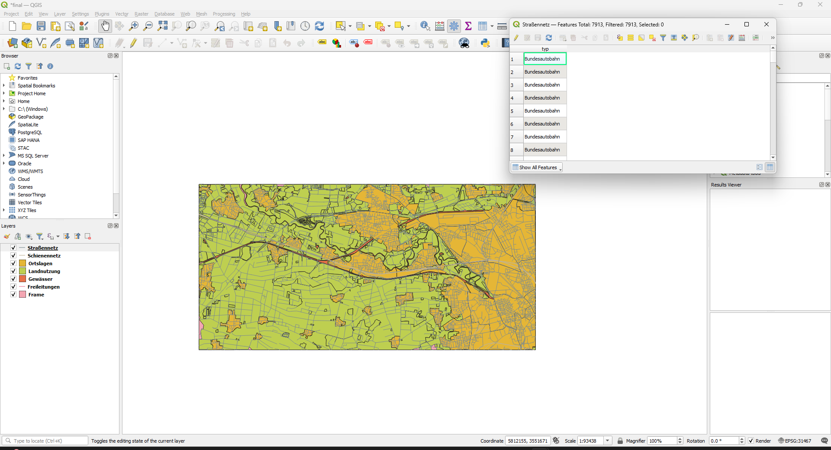
2
STEP 2 OF 5
Checking the data and its attributes
Opened the attribute table of each layer to find the fields the later analysis depends on.
Road class (Kreisstraße, Bundestraße, … ), Land use, water (‘Binnensee,Teich’, Kanal, …) and railways are classified in a typ field.
Notes:
Next I went through each layer's attribute table to find the fields the later analysis needs.
Each layer stores its class in a field called typ, roads, land use, water, and railways all work the same way.

Slide 5
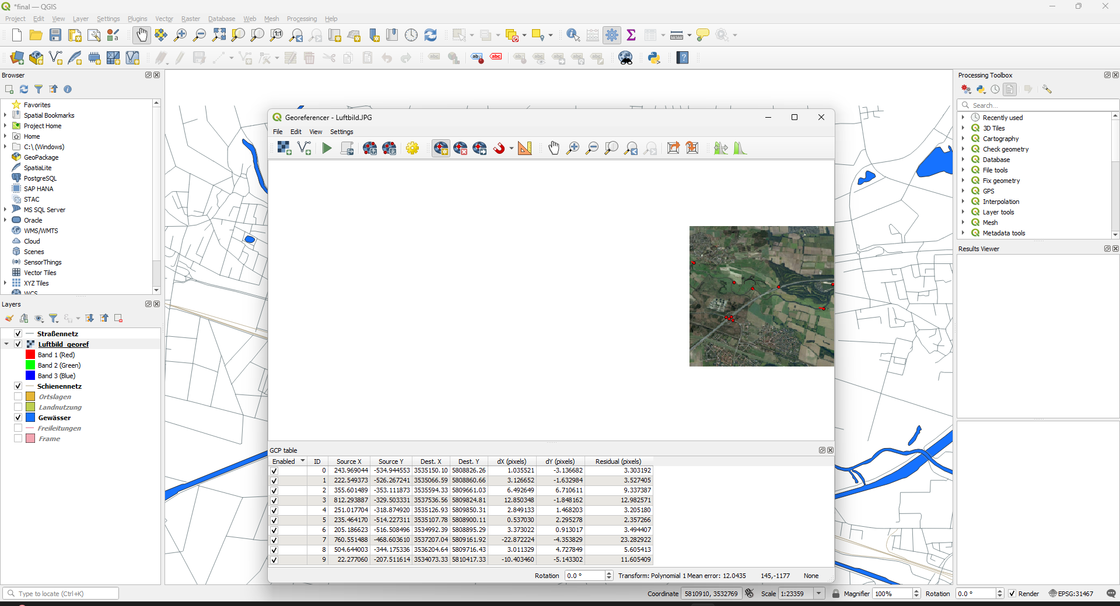
3
STEP 3 OF 5
Georeferencing the aerial photograph
The supplied aerial photograph had no spatial reference.
Placed ground control points by matching features in the photo (road junctions, water edges) to the vector layers.
Transformation: Polynomial 1 (affine), nearest-neighbour resampling, target EPSG:31467.
10 points placed; 1 outlier disabled, leaving 9 used for the fit.
12 px
→
5.1 px
all 10 points
9 points used · ≈ 20–25 m
Notes:
This step is georeferencing. We were given an aerial photograph of part of the area, but as a plain image it has no location. Georeferencing gives it real-world coordinates so it lines up with the other data. I pick features I can see in both the photo and the map, road junctions, water edges, and tell QGIS that this point in the image is this point on the map. I placed ten control points and used an affine transformation into our coordinate system. One of the ten was clearly a mis-click, with a much larger error than the rest, so I disabled it and recalculated from the other nine. That brought the mean error down from about 12 pixels to 5, which is roughly 20 to 25 metres on the ground.

Slide 6
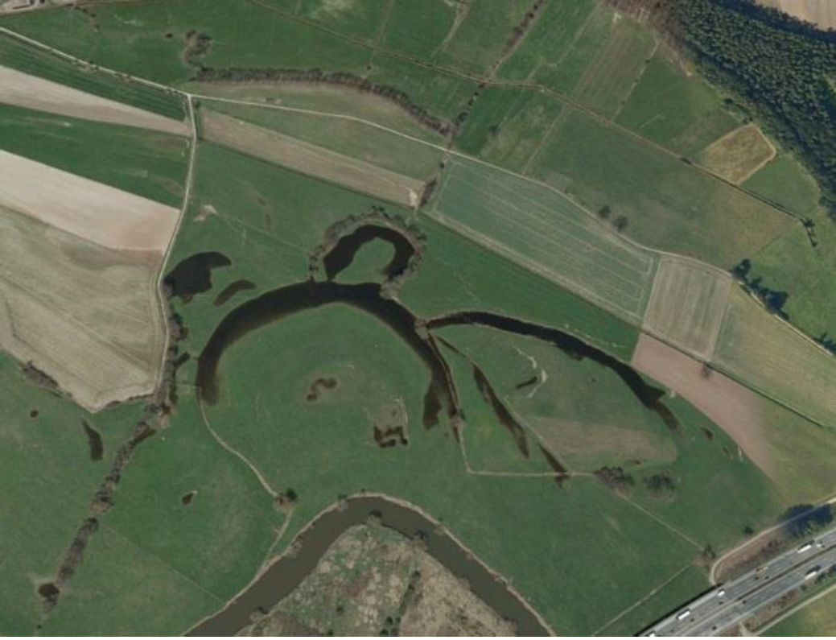
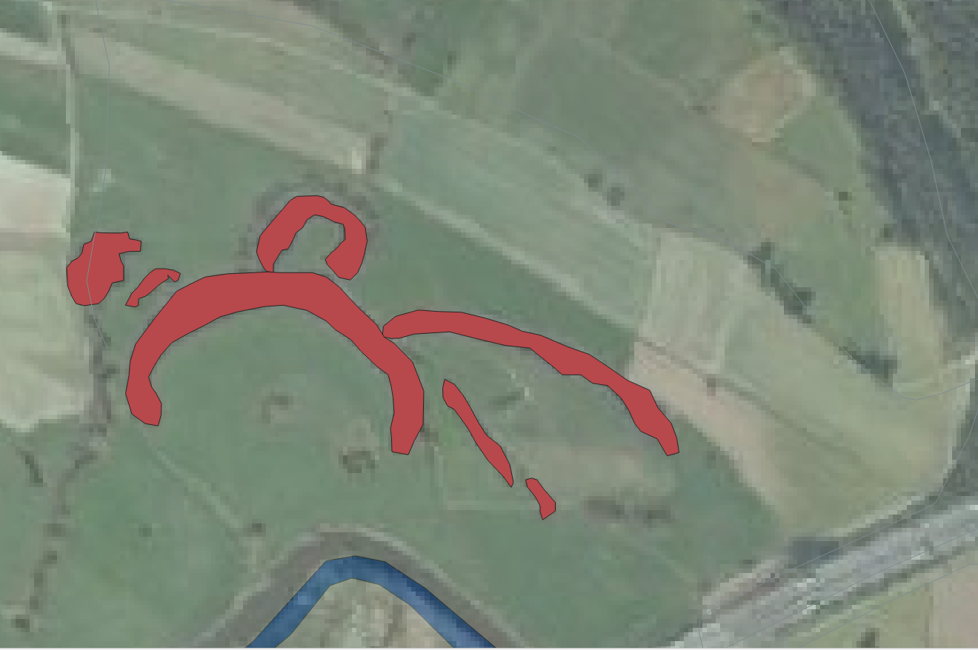
4
STEP 4 OF 5
Digitizing the oxbow arms of the Leine
The cut-off meander loops of the Leine are not in the water layer, so I traced them as new polygons. Result: 7 polygons in Altwasser.gpkg (field typ = 'Altwasser').
Aerial photograph — the oxbow arms are visible
Digitized result — 7 polygons over the aerial
Notes:
Now the digitizing. In the aerial photo, on the left, you can see these dark curved shapes — old cut-off meander loops of the Leine, called oxbows. They're treated as protected biotopes in our analysis so I created 7 layers. On the right is the result: I traced each loop by hand into a new polygon layer — seven polygons, saved as a GeoPackage. I didn't chase pixel-perfect edges, because these get a 200-metre protection buffer later anyway; what mattered was capturing the right water bodies.

Slide 7
5
STEP 5 OF 5
Producing the Digital Landscape Model map
Assembled all data layers, the georeferenced aerial and the digitized oxbows in the QGIS print layout.
Styled the road network by class (the typ field).
Added the four required map elements: title, legend, scale bar and north arrow.
Exported the finished layout as DLM.pdf.
Notes:
The last step in my part was the first map — the Digital Landscape Model. In the print layout I brought everything together: all the data layers, the georeferenced aerial photo, and the oxbows I'd just digitized. I styled the roads by class so the hierarchy is readable, added a title, legend, scale bar and north arrow, and exported it as a PDF. This is the map on screen.

Slide 8
Results & outputs
7
5.1 px
7
Map 1
layers prepared
in EPSG:31467
georeferencing
mean error
oxbow polygons
digitized
DLM map
produced
Notes:
To sum up my stage: seven layers prepared and verified in the correct coordinate system, the aerial photo georeferenced to about 5 pixels, seven oxbow polygons digitized, and the first map produced.

Slide 9
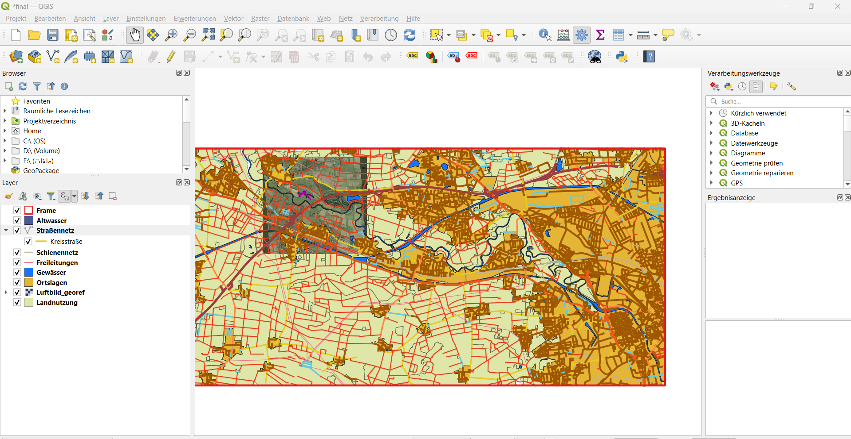
Methods for the Analysis and Modelling of Spatial Environmental Data
Buffer Analysis and
Exclusion Areas
West of Hanover
Safety Buffers · Settlement Classification · Total Exclusion Area
Khaled Alhamoud

Slide 10
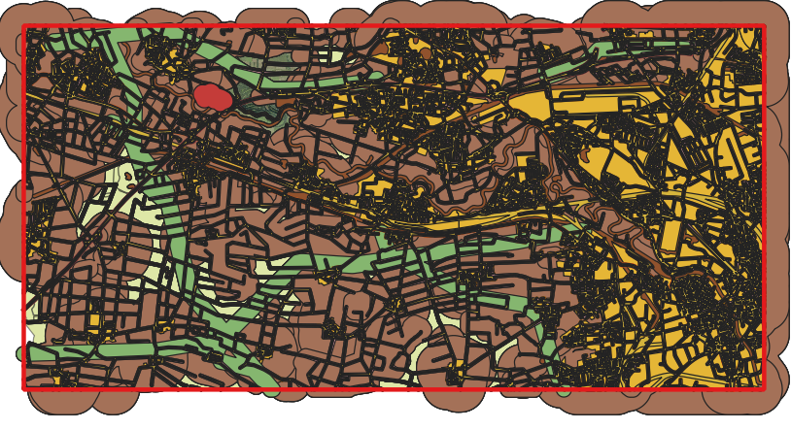
The task, and my part in it
Person 1 handed over the prepared DLM: seven layers, the georeferenced aerial photo, and the digitized oxbow arms. My stage turns every distance rule in the assignment into an actual exclusion layer — the mask Person 3 will subtract farmland from.
1
2
3
4
5
Check the data
Build 11 buffers
Split settlements
Combine
Check & hand over
one field, typ — and two compound values
11 distance rules → 11 layers
spatial join solves a missing attribute
Merge → Fix → Dissolve → Clip
Total_Exclusion_Area → Person 3
96.4%
of the study area ends up excluded
11 → 1
buffers dissolved into one clean mask
All eleven safety buffers, merged and colour-coded by class

Slide 11
1
STEP 1 OF 5
Checking the data first
Every class I need — road type, land use, water, rail — lives in a single field: typ. Nothing is split across separate attributes.
Landnutzung.shp holds 2,919 polygons across 20 unique typ values. Ortslagen.shp, by contrast, carries only place names — no settlement-type field at all.
Key finding: some values are compound strings. The semicolon in 'Wald; Forst' and the comma in 'Landesstraße, Staatsstraße' are part of the value itself, not a separator between two classes.
That means every selection has to match the string verbatim — no LIKE wildcards, no splitting on punctuation, or the filter silently returns nothing.
typ
the one field every selection is built on
Select strings verbatim — no LIKE, no splitting.

Slide 12
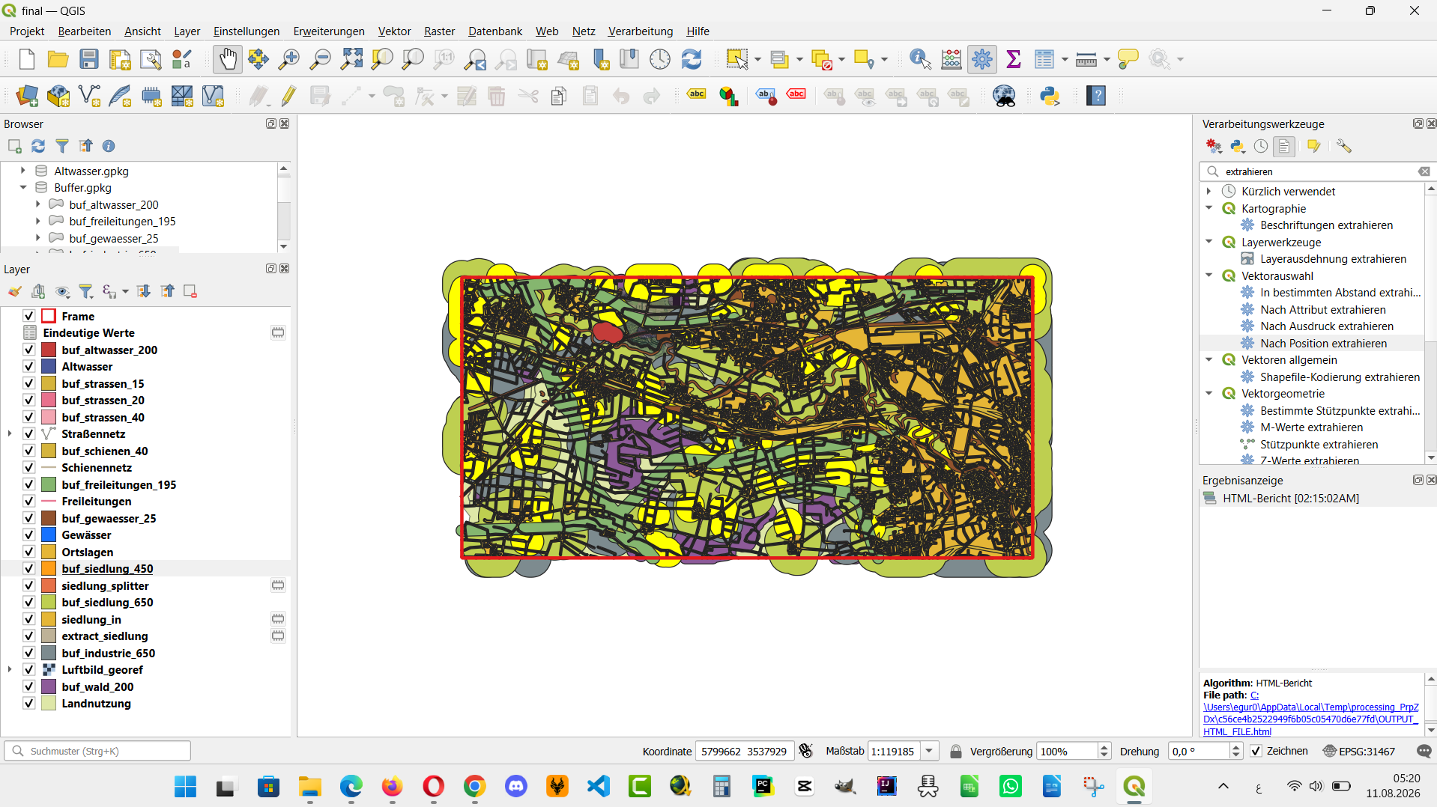
2
STEP 2 OF 5
Building the eleven safety buffers
Straßennetz.shp keeps every road class in one field (typ) — I only buffered the three categories the assignment names (Kreis-, Bundes-/Landes-, Bundesautobahn) and left Gemeindestraße and Weg untouched.
Distances range from 15 m for district roads up to 650 m for settlements — set with the Buffer tool, "dissolve result" switched on so same-class buffers merge automatically.
Same settings on every run for consistency: 16 segments per quarter-circle, round caps and joins.
Forest and oxbow arms (protected biotopes) both get a 200 m buffer; overhead power lines get 195 m — three times the 65 m rotor diameter.
All 11 buffers before merging
11 buffers
one per constraint class, 15 m to 650 m

Slide 13
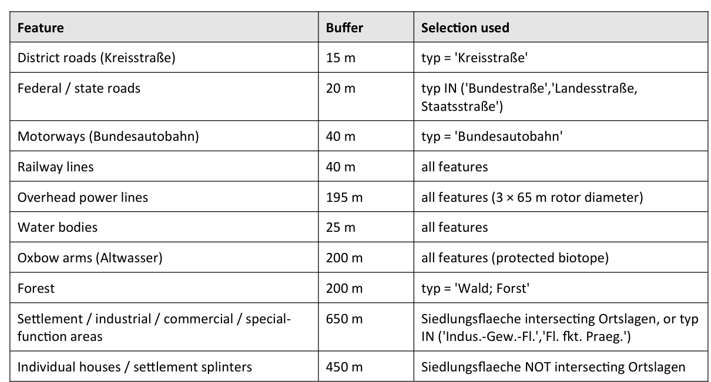
STEP 2 OF 5
Building the eleven safety buffers
All 11 buffers merged, before Total_Exclusion_Area is built

Slide 14
3
STEP 3 OF 5
The settlement classification problem
The assignment splits settlements into two classes with different distances: settlements 'assigned to a local location' (650 m) and individual houses or splinters that are not (450 m).
Landnutzung.shp doesn't carry that distinction — every settlement patch is just typ = 'Siedlungsflaeche', with nothing to tell the two apart.
Solved it spatially instead of by attribute: any Siedlungsflaeche polygon touching a named village in Ortslagen counts as assigned (650 m); anything that doesn't touch one is a splinter (450 m).
Result: 1,640 of 1,771 settlement polygons (≈3,231 ha) sit inside a named village; 131 (≈118 ha) stand on their own.
1,640 / 131
settlement patches: assigned vs. splinter
650 / 450 m
buffer distance for each class
No attribute solved this — a spatial join with Ortslagen did.

Slide 15
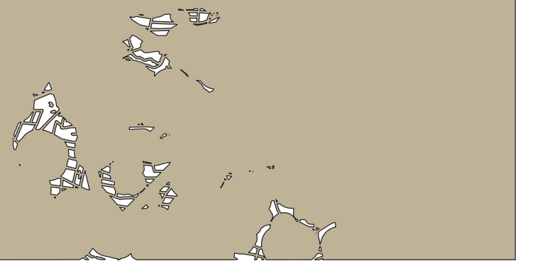
4
STEP 4 OF 5
Merging everything into one exclusion layer
1
Merge
all 11 buffer layers combined into a single layer
2
Fix geometries
cleaned up before dissolving, not after — repairing first keeps the topology clean going into the dissolve
3
Dissolve
no grouping field, so every touching buffer melts into one shape with no leftover internal lines
4
Clip
cut to the Frame boundary, so buffers sticking out past the study area don't count
Total_Exclusion_Area
One feature-a single MultiPolygon object

Slide 16
STEP 5 OF 5
5
Results & outputs
Being precise here mattered: the assignment's own '~200 km²' is a rough figure. The Frame boundary actually measures 181.78 km² — and that's the number the final percentage is built on.
181.78 km²
96.4%
658 ha
1
study area (Frame),
measured, not estimated
of the area excluded
once every buffer applies
left over — scattered
candidate patches for Person 3
final exclusion feature,
clipped to the Frame
Files produced
Total_Exclusion_Area.gpkg — final exclusion layer — main deliverable
Buffer.gpkg — all 11 buffers + merged/dissolved intermediates, kept for traceability
Altwasser.gpkg / Luftbild_georef.tif — carried over from Person 1

Slide 17
Key expressions & formulas
Copy-ready, and verified against the data before use
1 · Selection expressions
2 · Spatial split (Extract by location)
"typ" = 'Kreisstraße' → 15 m
"typ" IN ('Bundestraße','Landesstraße, Staatsstraße') → 20 m
"typ" = 'Bundesautobahn' → 40 m
"typ" = 'Wald; Forst' → 200 m
"typ" IN ('Indus.-Gew.-Fl.','Fl. fkt. Praeg.') → 650 m
"typ" = 'Siedlungsflaeche' → extract
Siedlungsflaeche ∩ Ortslagen (intersects) → 650 m
Siedlungsflaeche \ Ortslagen (disjoint) → 450 m
3 · Area & exclusion rate
A_ha = $area / 10000
P_ex = (17,519.48 / 18,177.8) × 100 ≈ 96.4%
4 · Tested, then removed — no effect
$area < 10,000,000
→ largest forest polygon: 261.8 ha
→ largest settlement polygon: 22.0 ha
→ both far below the threshold, so the filter excluded nothing
Verbatim strings only
no LIKE, no wildcards, no splitting on ';' or ','

Slide 18
The task, and my part in it
1
2
3
4
5
Filter the grassland and arable land areas
Merge adjacent polygons into a single continuous area
Remove restricted zones
Filter the areas with an area greater than 18 ha
created the map

Slide 19
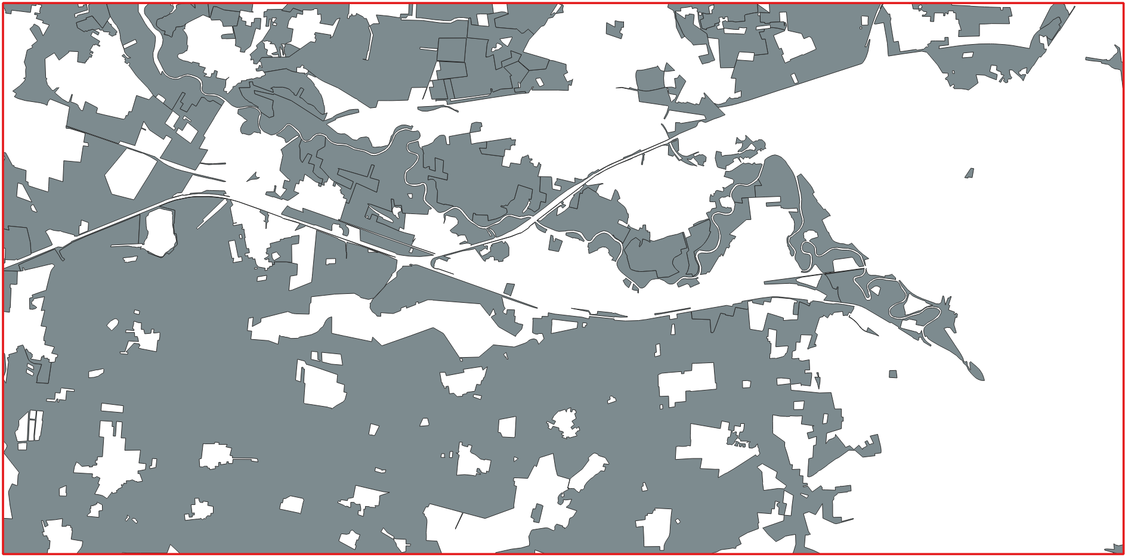
1
STEP 1 OF 5
Filter the grassland and arable land areas
Input: Landnutzung layer
Tool: Extract by Expression
Expression: "typ" IN ('Ackerland', 'Gruenland')
the grassland and arable land areas
Notes:
From the Landnutzung layer, I used the Extract by Expression tool with the expression "typ" IN ('Ackerland', 'Gruenland') and obtained the result shown in the figure above.
The gray areas represent the Grünland and Ackerland areas after filtering.

Slide 20
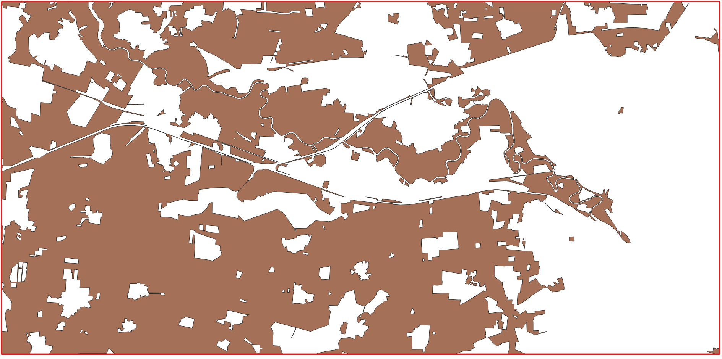
2
STEP 2 OF 5
Merge adjacent polygons into a single continuous area and remove the internal boundaries between them.
Input: layer of the grassland and arable land areas
Tool: Dissolve
the grassland and arable land areas after remove boundary
the grassland and arable land areas
Notes:
Next, I merged adjacent areas into larger continuous areas using the Dissolve tool. This step is important because the 18 ha criterion applies to a continuous area, not to each original parcel individually. For example, a 10 ha Ackerland polygon directly adjacent to a 10 ha Grünland polygon can form a continuous 20 ha area after applying Dissolve.

Slide 21
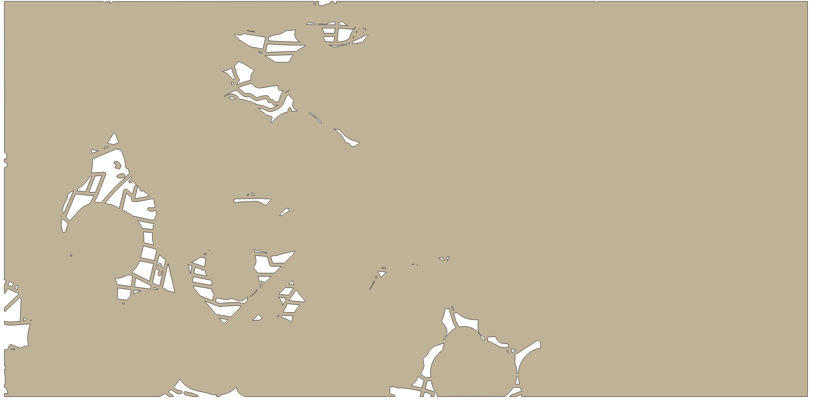

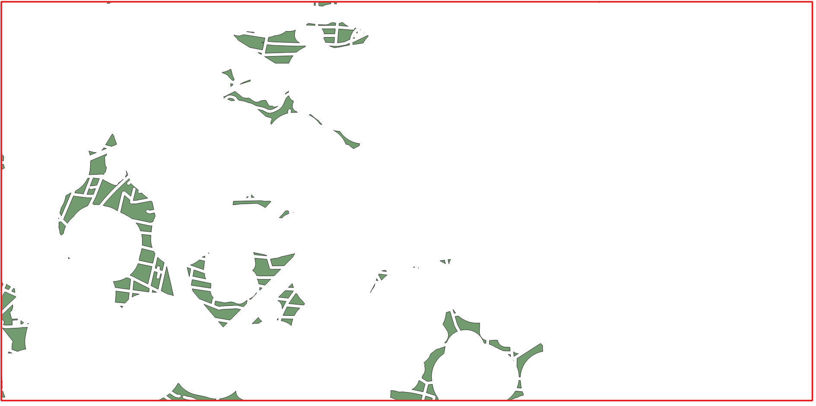
3
STEP 3 OF 5
Remove all parts of the Ackerland/Grünland areas that lie within the restricted zones.
Input: layer after dissolve + Total_Exclusion_Area layer
Tool: Difference
+
+
the grassland and arable land areas after remove boundary
The land areas that meet the criteria and are located at a sufficient distance from roads and rivers.
Günland and Ackerland that meet the criteria and are located at a sufficient distance from roads and rivers.
Notes:
Next, I used the Difference tool to remove restricted areas, such as railway lines, roads, and rivers, based on the previously prepared Egur map.
As a result, I obtained the suitable Ackerland and Grünland areas for wind farm development, which are marked in green on the map.

Slide 22

4
STEP 4 OF 5
Filter the areas with an area greater than 18 ha.
Input: layer after diffirent
Tool: Extract by Expression
Expression: $area >= 180000 m² (1 ha = 10.000 m²)
Suitable land for Wind Farm Areas
Notes:
Finally, I used the Extract by Expression tool to filter the areas with a size of 18 ha or more, obtaining the final result.
Finally, I created the map layout and obtained the final result shown in the image

Slide 23
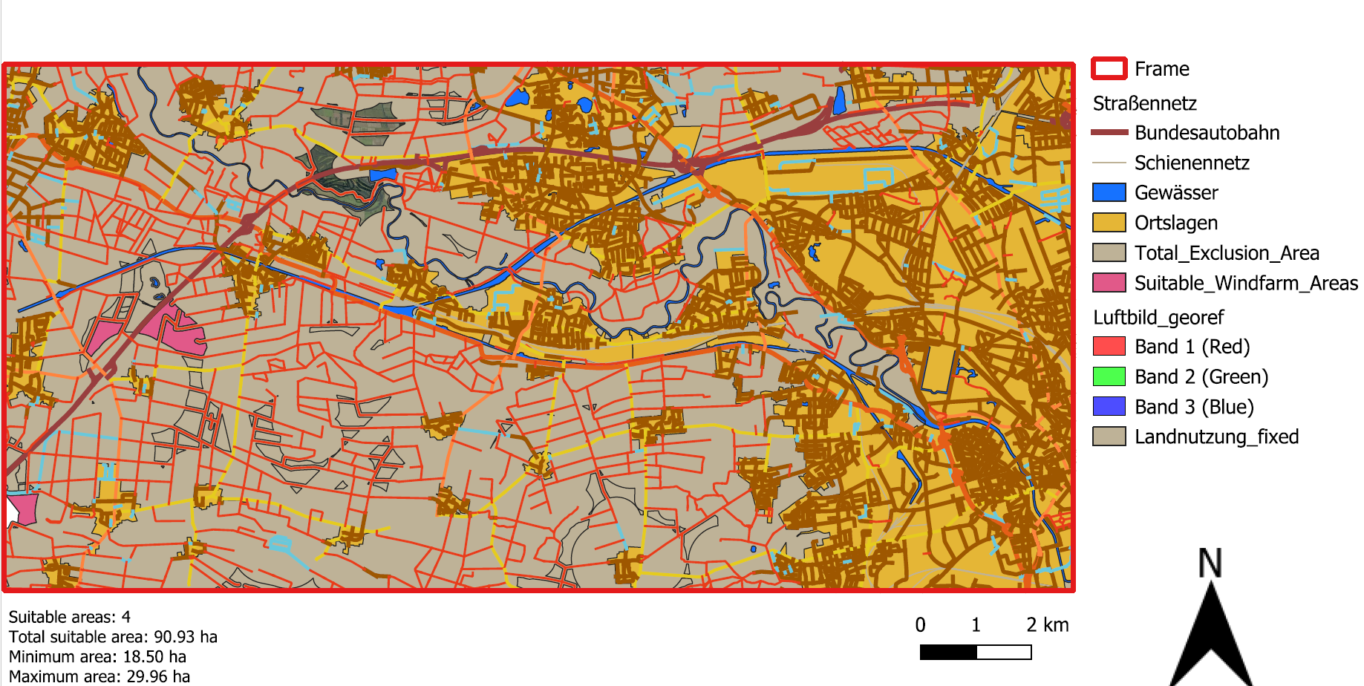
5
STEP 5 OF 5
Producing the Digital Landscape Model map
final Result

Slide 24
STEP 5 OF 5
5
Results & outputs
4 suitable areas
Total area: 90,93 ha
Individual areas: from 18.5 to 29,96
The suitable areas are concentrated
mainly in the western and southwestern
Reason: high density of settlements,
, transport infrastructure
, water bodies
final Result
Notes:
The analysis identified four suitable areas with a total area of approximately 90.93 ha. The individual areas range from approximately 18.50 ha to 29.96 ha.
Spatially, the suitable areas are concentrated mainly in the western and southwestern parts of the study area. Very few suitable areas remain in the central and eastern parts. This pattern can be explained by the high density of settlements, transport infrastructure, water bodies, and other protected features. Their overlapping buffer zones exclude a large proportion of the study area, which further reduces the number of feasible sites.

